Slide 1
hapter 3
C
Inheritance

Slide 2
Inheritance
Object-oriented programming allows you to define new classes from existing classes. This is called inheritance.
Inheritance is a fundamental concept in object-oriented programming (OOP) that allows a class to inherit properties and methods from another class.
Inheritance that allows you to create a new class by inheriting the properties and behavior of an existing class.
Inheritance enables you to reuse existing code and to define new classes based on existing class (superclass).
– The new class is called the subclass or child class, and it inherits all the non-private members (fields, methods, and nested classes) of the superclass.

Slide 3
Super classes and Subclasses
In Java terminology, a class C1 extended from another class C2 is called a subclass, and C2 is called a superclass.
Example:
class C1 extends C2
{
//body
}
A superclass is also referred to as a parent class or a base class, and a subclass as a child class, an extended class, or a derived class.
A subclass inherits accessible data fields and methods from its superclass and may also add new data fields and methods.

Slide 4
Cont…
Suppose you need to define classes to model circles and rectangles.
– These classes have many common features.
What is the best way to design these classes so as to avoid redundancy and make the system easy to understand and easy to maintain?
Inheritance enables you to define a general class (e.g., a superclass) and later extend it to more specialized classes (e.g., subclasses).
Different classes may have some common properties and behaviors, which can be generalized in a class that can be shared by other classes.
You can define a specialized class that extends the generalized class.
The specialized classes inherit the properties and methods from the general class.

Slide 5
Cont..
Example
The Circle class inherits all accessible data fields and methods from the GeometricObject class.
In addition, it has a new data field, radius, and its associated get and set methods.
The Circle class also contains the getArea() , getPerimeter() , and getDiameter() methods for returning the area, perimeter, and diameter of the circle.
The Rectangle class inherits all accessible data fields and methods from the GeometricObject class.
In addition, it has the data fields width and height and their associated get and set methods.
It also contains the getArea() and getPerimeter() methods for returning the area and perimeter of the rectangle.

Slide 6
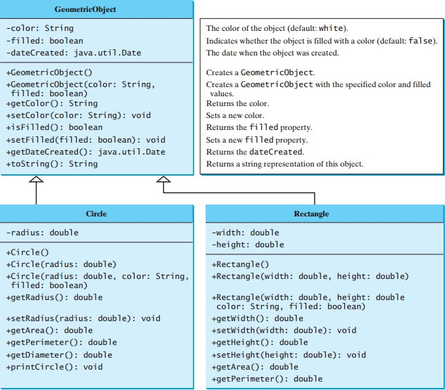
Super classes and Subclasses

Slide 7
GeometricObject Superclass
Example 1:
Import java.util.Date;
public class GeometricObject { private String color = "white"; private boolean filled; private Date dateCreated;
/** Construct a default geometric object */
public GeometricObject() { dateCreated = new Date();
}
/** Construct a geometric object with the specified color
* and filled value */
public GeometricObject(String color, boolean filled) { dateCreated = new Date();
this.color = color;
this.filled = filled;
}
/** Return color */
public String getColor() {
return color;
}
/** Set a new color */
public void setColor(String color) {
this.color = color;
}

Slide 8
GeometricObject Superclass
/** Return filled. */
public boolean isFilled() {
return filled;
}
/** Set a new filled */
public void setFilled(boolean filled) {
this.filled = filled;
}
/** Get dateCreated */
public Date getDateCreated() {
return dateCreated;
}
/** Return a string representation of this object*/
public String toString() {
return "created on " + dateCreated + "\ncolor: "
+ color + " and filled: " + filled;
}
}

Slide 9
Circle Subclass
public class Circle extends GeometricObject{
private double radius;
public Circle() {
}
public Circle(double radius) {
this.radius = radius;
}
public Circle(double radius, String color, boolean filled) {
this.radius = radius; setColor(color); setFilled(filled);
}
/** Return radius */ public double getRadius() { return radius;
}
/** Set a new radius */
public void setRadius(double radius) {
this.radius = radius;
}

Slide 10
Circle Subclass
/** Return area */
public double getArea() {
return radius * radius * Math.PI;
}
/** Return diameter */ public double getDiameter() { return 2 * radius;
}
/** Return perimeter */ public double getPerimeter() { return 2 * radius * Math.PI;
}
/** Print the circle info */
public void printCircle() {
System.out.println("The circle is created " +
getDateCreated()+ " and the radius is " + radius);
}
}

Slide 11
Circle Subclass
The keyword extends tells the compiler that the
Circle class extends the GeometricObject class.
– Thus inheriting the methods getColor, setColor, isFilled, setFilled, and toString.
The overloaded constructor Circle(double radius, String color, boolean filled) is implemented by invoking the setColor and setFilled methods to set the color and filled properties .
These two public methods are defined in the base class GeometricObject and are inherited in Circle, so they can be used in the derived class.

Slide 12

Circle Subclass

Slide 13
Rectangle Subclass
public class Rectangle extends GeometricObject {
private double width;
private double height;
public Rectangle() {
}
public Rectangle(double width, double height) {
this.width = width;
this.height = height;
}
public Rectangle( double width, double height, String color,
boolean filled) { this.width = width; this.height = height; setColor(color); setFilled(filled);
}
/** Return width */ public double getWidth() { return width;
}

Slide 14
Rectangle Subclass
/** Set a new width */
public void setWidth(double width) {
this.width = width;
}
/** Return height */
public double getHeight() {
return height;
}
/** Set a new height */
public void setHeight(double height) {
this.height = height;
}
/** Return area */ public double getArea() { return width * height;
}
/** Return perimeter */ public double getPerimeter() { return 2 * (width + height);
}
}
14

Slide 15

Rectangle Subclass
The keyword extends tells the compiler that the Rectangle class extends the GeometricObject class, thus inheriting the methods getColor, setColor, isFilled, setFilled, and toString.

Slide 16
Rectangle Subclass
The following code creates objects of Circle and Rectangle and invokes the methods on these objects.
The toString() method is inherited from the GeometricObject class and is invoked from a Circle object and a Rectangle object.

Slide 17
TestCircleRectangle Class
public class TestCircleRectangle {
public static void main(String[] args) {
Circle circle = new Circle(1);
System.out.println("A circle " + circle.toString());
System.out.println("The color is “+ circle.getColor());
System.out.println("The radius is “+ circle.getRadius());
System.out.println("The area is "+ circle.getArea());
System.out.println("The diameter is “+ circle.getDiameter());
Rectangle rectangle = new Rectangle(2, 4);
System.out.println("\nA rectangle " + rectangle.toString() ); System.out.println("The area is " + rectangle.getArea()); System.out.println("The perimeter is " + rectangle.getPerimeter() );
}
}

Slide 18
Dog Class
Example 2:
public class Dog {
private String name;
public Dog(String n) { name = n;
}
public String getName() { return name;
}
public void speak() { System.out.println("Woof");
}
}

Slide 19
Cat Class
public class Cat {
private String name;
public Cat(String n)
{
name = n;
}
public String getName()
{
return name;
}
public void speak() { System.out.println("Meow");
}
}

Slide 20
Problem: Code Duplication
Dog and Cat have the name field and the
getName method in common.
Classes often have a lot of state and behavior in common
Result: lots of duplicate code!

Slide 21
Solution: Inheritance
Inheritance allows you to write new classes that inherit from existing classes
The existing class whose properties are inherited is called the "parent" or superclass
The new class that inherits from the super class is called the "child" or subclass
Result: Lots of code reuse!

Slide 22
Dog
String name String getName() void speak()
Cat
String name String getName() void speak()
using
inheritance
superclass
Animal
String name
String getName()
subclass
subclass
Dog void speak() |  |  | Cat void speak()

Slide 23
Animal Superclass
public class Animal {
private String name; public Animal(String n) {
name = n;
}
public String getName() { return name;
}
}

Slide 24
Dog Subclass
public class Dog extends Animal { public Dog(String n) {
super(n); // calls Animal constructor
}
public void speak() {
return System.out.println("Woof");
}
}

Slide 25
Cat Subclass
public class Cat extends Animal {
public Cat(String n)
{
super(n); // calls Animal constructor
}
public void speak()
{
return System.out.println("Meow");
}
}

Slide 26
Types of inheritance
Single level inheritance:- Inheritance in which a class inherits from only one super class.
Multi-level inheritance:- Inheritance in which a class inherits from a class which itself inherits from another class.
  Here a minimum of three classes is required.
Hierarchy inheritance:- Here two or more classes inherits from one class. Multiple classes inherit from a single superclass.
Multiple inheritance:- A class inherits from two or more classes. Java does not support multiple inheritance of classes, where a class can inherit from multiple classes. However, Java supports multiple inheritance through interfaces.
Hybrid Inheritance: is a combination of multiple inheritance and multilevel inheritance.

Slide 27
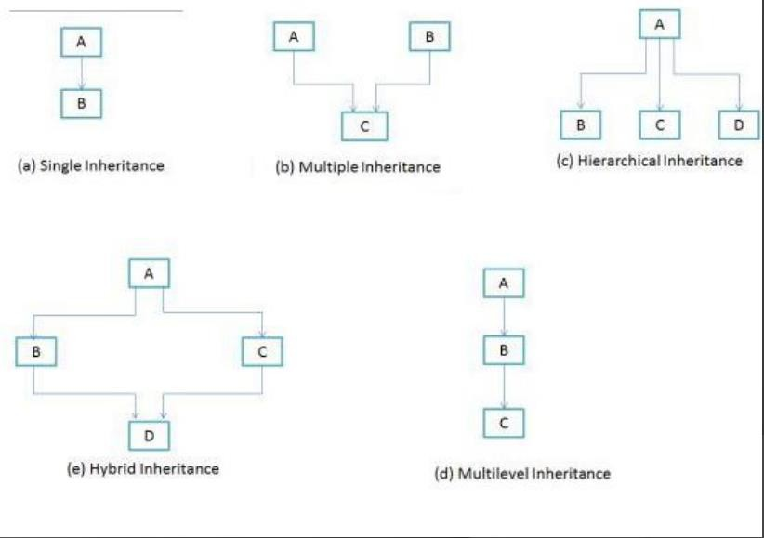
Inheritance Types

Slide 28
Method Overriding and Overloading
Method overriding occurs when a subclass provides its own implementation of a method that is already defined in its superclass.
In other words, the subclass redefines the behavior of an inherited method.
The method in the subclass must have the same name, return type, and parameters as the method in the superclass.
28

Slide 29
Method Overriding
Example:
class Animal {
public void makeSound() {
System.out.println("Generic animal sound");
}
}
class Cat extends Animal {
@Override
public void makeSound() { System.out.println("Meow");
}
}
public class Main {
public static void main(String[] args) {
Animal animal = new Animal();
animal.makeSound(); // Output: Generic animal sound
Cat cat = new Cat(); cat.makeSound(); // Output: Meow
}}
29

Slide 30
Overriding Methods
Several points are worth noting:
  An instance method can be overridden only if it is accessible.
    Thus a private method cannot be overridden, because it is not accessible outside its own class.
    If a method defined in a subclass is private in its superclass, the two methods are completely unrelated.
  Like an instance method, a static method can be inherited.
    However, a static method cannot be overridden.
    If a static method defined in the superclass is redefined in a
subclass, the method defined in the superclass is hidden.
    The hidden static methods can be invoked using the syntax
SuperClassName.staticMethodName.

Slide 31
Method Overloading
Method overloading occurs when a class has multiple methods with the same name but different parameters.
The methods must have the same name but differ in the number, type, or order of the parameters.
This allows for more flexibility in how methods are called, as different versions of the method can handle different argument combinations.

Slide 32
Method Overloading
Example:
class MathArthimetic {
public int add(int a, int b) {
return a + b;
}
public double add(double a, double b) { return a + b;
}
}
public class Main {
public static void main(String[] args) { MathArthimetic math = new MathArthimetic(); System.out.println(math.add(5, 10)); // Output: 15
System.out.println(math.add(2.5, 3.7)); // Output: 6.2
}
}

Slide 33
Overriding vs. Overloading
Overloading means to define multiple methods with the same name but different signatures.
Overriding means to provide a new implementation for a method in the subclass.
To override a method, the method must be defined in the subclass using the same signature and the same return type.

Slide 34
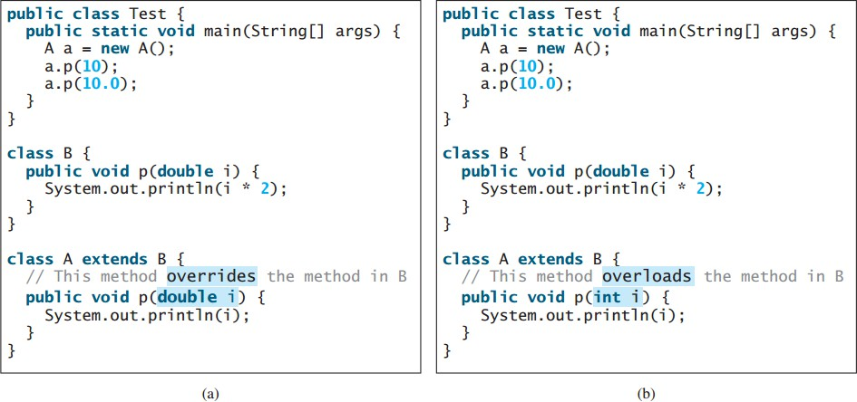
Overriding vs. Overloading

Slide 35
Overriding vs. Overloading
When you run the Test class in (a), both a.p(10) and a.p(10.0) invoke the p(double i) method defined in class A to display 10.0.
When you run the Test class in (b), a.p(10) invokes the p(int i) method defined in class A to display 10, and a.p(10.0) invokes the p(double i) method defined in class B to display 20.0.

Slide 36
Overriding vs. Overloading
Note:
  Overridden methods are in different classes related by inheritance; overloaded methods can be either in the same class or different classes related by inheritance.
  Overridden methods have the same signature and return type; overloaded methods have the same name but a different parameter list.
  To avoid mistakes, you can use a special Java syntax, called override annotation, to place @Override before the method in the subclass.

Slide 37
Cont..
For example:
public class Circle extends GeometricObject
{
// Other methods are omitted
@Override
public String toString()
{
return super.toString() + "\nradius is " +
radius;
}
}

Slide 38
super Keyword in java
In Java, the super keyword is used to refer to the superclass of a class.
It is primarily used to access members (variables or methods) of the superclass, which may be hidden or overridden in the subclass.
The super keyword can be used for:
Accessing superclass members.
Invoking superclass constructors.

Slide 39
Cont…
Accessing superclass members.
  When a subclass overrides a method or hides a variable of its superclass, you can use the super keyword to access the hidden or overridden member of the superclass. syntax: super.method(parameters);
  It is especially useful when you want to invoke the superclass implementation of an overridden method. For example:
class Animal {
String sound() {
return "Animal is making a sound";
}}
class Dog extends Animal {
@Override
String sound() {
return "Dog is barking";
}
String superSound() {
return super.sound();
// accessing superclass method
}}
class main {
public static void main(String[] args)
{
Dog dog = new Dog(); System.out.println(dog.sound());
// Output: Dog is barking
System.out.println(dog.superSound());
// Output: Animal is making a sound
}
}
39

Slide 40
Cont…
Invoking superclass constructors.
  In a subclass constructor, you can use the super keyword to invoke the constructor of the superclass.
  This is useful when you want to reuse the initialization logic of the superclass. The super() call must be the first statement in the subclass constructor. For example:
class Vehicle { String color;
Vehicle(String color) { this.color = color;
}}
class Car extends Vehicle { int speed;
Car(String color, int speed) {
super(color);
// invoking superclass constructor this.speed = speed;
}
}
class main {
public static void main(String[] args)
{
Car car = new Car("Red", 100); System.out.println(car.color);
// Output: Red System.out.println(car.speed);
// Output: 100}
}
40

Slide 41
Chapter 4
Polymorphism abstract class and interface

Slide 42
Polymorphism
Polymorphism is one of the key feature of object-oriented programming, and it refers to the ability of an object to take on many forms.
In Java, polymorphism allows objects of different classes to be treated as objects of a common superclass to write more flexible and reusable code.
Generally, Polymorphism means that a variable of a supertype can refer to a subtype object.
Polymorphism means "many forms", and it occurs when we have
many classes that are related to each other by inheritance.

Slide 43
Polymorphism
There are two main types of polymorphism in Java:
compile-time polymorphism (also known as method overloading)
runtime polymorphism (also known as method overriding).
Compile-time polymorphism
  It occurs when there are multiple methods with the same name but
different parameters in a class.
  The appropriate method to invoke is determined by the compiler based on the number, type, and order of the arguments passed to the method.
  Method overloading allows you to define multiple methods with the same name but perform different operations, providing a convenient way to use the same method name with different inputs.

Slide 44
Cont…
Example: Compile-time polymorphism
public class Calculator {
public int add(int a, int b) { return a + b;
}
public double add(double a, double b)
{
return a + b;
}
}
// Usage
Calculator calculator = new Calculator();
int result1 = calculator.add(2, 3);
// Calls the int version of add() double result2 = calculator.add(2.5, 3.7);
// Calls the double version of add()

Slide 45
Polymorphism
Runtime polymorphism
It occurs when a subclass provides a specific implementation of a
method that is already defined in its superclass.
The method in the subclass must have the same name, return type, and parameters as the method in the superclass.
The appropriate method to invoke is determined at runtime, based on the actual type of the object.
Runtime polymorphism allows you to override methods to provide specialized behavior for specific subclasses, while still maintaining a common interface.

Slide 46
Cont…
Example: Runtime polymorphism
class Animal {
public void sound() {
System.out.println("Animal is making a sound");
}
}
class Cat extends Animal { @Override
public void sound() { System.out.println("Meow");
}
}
class Dog extends Animal { @Override
public void sound() { System.out.println("Woof");
}
}
Public class Main
{
Public static void main(String[] args)
{
Animal animal1 = new Cat();
// Cat object assigned to Animal
reference
Animal animal2 = new Dog();
// Dog object assigned to Animal reference
animal1.sound();
// Calls the sound() method of Cat class
animal2.sound();
// Calls the sound() method of Dog class
}
}

Slide 47
The Abstract Class
Data abstraction is the process of hiding certain details and showing only essential information to the user.
Abstraction in java can be achieved with either abstract classes or interfaces.
In Java, an abstract class is a class that cannot be instantiated directly, but can be used as a base for other classes.
Abstract methods: is a method that is declared without an implementation and can only be used in an abstract class.
It provides the method signature without specifying the method body.
Subclasses of the abstract class must implement these abstract methods.

Slide 48
Cont….
Concrete methods: Apart from abstract methods, an abstract class can also contain concrete (non-abstract) methods.
Concrete methods have a complete implementation and can be directly
used by the abstract class or its subclasses.
Instance variables: An abstract class can have instance variables that are inherited by its subclasses.
These variables can be accessed and used by the abstract class itself or its
subclasses.
Constructors: An abstract class can have constructors, which are used to
initialize the instance variables of the abstract class.
The constructors are called when an instance of a concrete subclass is created.
Cannot be instantiated: An abstract class cannot be instantiated directly
using the new keyword.
.

Slide 49
An abstract class can contain abstract methods, which are implemented in concrete subclasses.
In previous section, we have defined the superclass GeometricObject for subclasses Circle and Rectangle.
GeometricObject models common features of geometric objects.
Both Circle and Rectangle contain the getArea() and getPerimeter() methods for computing the area and perimeter of a circle and a rectangle.
Since you can compute areas and perimeters for all geometric objects, it is better to define the getArea() and getPerimeter() methods in the GeometricObject class.
However, these methods cannot be implemented in the GeometricObject class, because their implementation depends on the specific type of geometric object.

Slide 50
Such methods are referred to as abstract methods.
After you define the methods in GeometricObject, it becomes an abstract class.
Abstract classes are denoted using the abstract modifier in the class header.
In UML graphic notation, the names of abstract classes and their abstract methods are italicized, as shown in the following Figure.

Slide 51
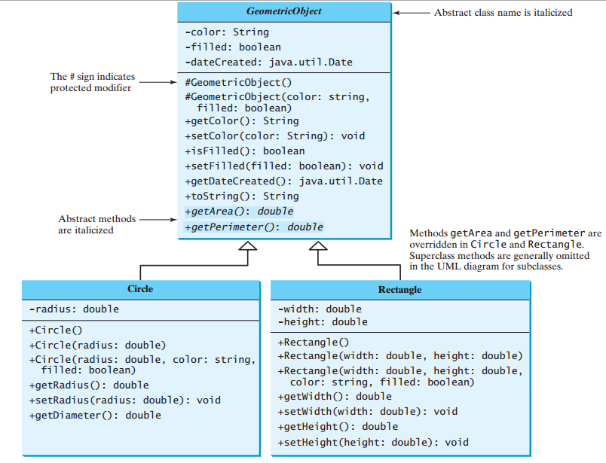
Abstract Classes and Abstract Methods

Slide 52
Abstract Classes and Abstract Methods
public abstract class GeometricObject {
private String color = "white";
private boolean filled;
private java.util.Date dateCreated;
/** Construct a default geometric object */
protected GeometricObject() {
dateCreated = new java.util.Date();
}
/** Construct a geometric object with color and filled value */
protected GeometricObject(String color, boolean filled) {
dateCreated = new java.util.Date();
this.color = color;
this.filled = filled;
}
/** Return color */
public String getColor() {return color; }
/** Set a new color */
public void setColor(String color) {
this.color = color;
}

Slide 53
Abstract Classes and Abstract Methods
/** Return filled.*/
public boolean isFilled() {
return filled;
}
/** Set a new filled */
public void setFilled(boolean filled) {
this.filled = filled;
}
/** Get dateCreated */
public java.util.Date getDateCreated() {
return dateCreated;
}
/** Abstract method getArea */
public abstract double getArea();
/** Abstract method getPerimeter */
public abstract double getPerimeter();
}

Slide 54
Abstract Classes and Abstract Methods
Abstract classes are like regular classes, but you cannot create instances of abstract classes using the new operator.
An abstract method is defined without implementation. Its implementation is provided by the subclasses.
A class that contains abstract methods must be defined as abstract.
The constructor in the abstract class is defined as protected, because it is used only by subclasses.
When you create an instance of a concrete subclass, its superclass’s constructor is invoked to initialize data fields defined in the superclass.

Slide 55
Cont…
The GeometricObject abstract class defines the common features (data fields and methods) for geometric objects and provides appropriate constructors.
Because you don’t know how to compute areas and perimeters of geometric objects, getArea and getPerimeter are defined as abstract methods.
These methods are implemented in the subclasses.
The implementation of Circle and Rectangle is shown in the following code.

Slide 56
Cont….
class Circle extends GeometricObject {
private double radius;
public Circle(String color, double radius)
{
super(color);
public double getArea()
{ return Math.PI * radius * radius;
}
}

Slide 57
Cont….
example
class Rectangle extends GeometricObject{ private double length; private double width;
public Rectangle(String color, double length, double width) {
super(color); this.length = length; this.width = width;
}
@Override
public double getArea() { return length * width;
}
}
public class AbstractClassExample {
public static void main(String[] args) {
Circle circle = new Circle("Red", 5.0);
GeometricObject rectangle = new Rectangle("Blue", 3.0, 4.0);
circle.displayColor();
// Output: The color of the shape is: Red System.out.println("Area of the circle: " + circle.getArea());
// Output: Area of the circle: 78.53981633974483 rectangle.displayColor();
// Output: The color of the shape is: Blue System.out.println("Area of the rectangle: " + rectangle.getArea());
// Output: Area of the rectangle: 12.0
}
}

Slide 58
Interface in Java
Another way to achieve abstraction in Java, is with interfaces.
An interface is a completely "abstract class" that is used to group
related methods with empty bodies.
In Java, an interface is a reference type that defines a contract of methods and constants that a class must implement.
It provides a way to achieve multiple inheritance by allowing a class to implement multiple interfaces.
An interface defines what methods a class should have without providing the implementation details.

Slide 59
key characteristics of Interface in Java
Like abstract classes, interfaces cannot be used to create objects.
Interface methods do not have a body - the body is provided by the
"implement" class.
On implementation of an interface, you must override all of its methods.
Interface methods are by default abstract and public
Interface attributes are by default public, static and final
An interface cannot contain a constructor (as it cannot be used to
create objects).
Note: To define an interface in Java, you use the interface keyword.

Slide 60
Interface in Java example
class Cat implements Animal {
@Override
public void makeSound() { System.out.println("Meow!");
}
@Override
public String getSpecies() { return "Feline";
}}
public class InterfaceExample {
public static void main(String[] args) { Animal dog = new Dog(); dog.makeSound();
// Output: Woof!
System.out.println(dog.getSpecies());
// Output: Canine
Animal cat = new Cat(); cat.makeSound(); // Output: Meow! System.out.println(cat.getSpecies());
// Output: Feline System.out.println(Animal.KINGDOM);
// Output: Animalia
}}
example
interface Animal {
void makeSound();
// Abstract method declaration String getSpecies();
// Abstract method declaration
// Constant declaration
String KINGDOM = "Animalia";
}
class Dog implements Animal { @Override
public void makeSound() { System.out.println("Woof!");
}
@Override
public String getSpecies() {
return "Canine";
}
}
57

Slide 61
Why And When To Use Interfaces?
To achieve security - hide certain details and only show the important details of an object (interface).
Java does not support "multiple inheritance" (a class can only
inherit from one superclass).
  However, it can be achieved with interfaces, because the class can implement multiple interfaces.
  Note: To implement multiple interfaces, separate them with a
comma. Example
class DemoClass implements FirstInterface, SecondInterface { public void myMethod() {
System.out.println("Some text..");
}
public void myOtherMethod() { System.out.println("Some other text...");
}}
class Main {
public static void main(String[] args) { DemoClass myObj = new DemoClass(); myObj.myMethod(); myObj.myOtherMethod(); }}
interface FirstInterface {
public void myMethod();
// interface method
}
interface SecondInterface {
public void myOtherMethod();
// interface method
}
58

Slide 62




59

